Slide 1
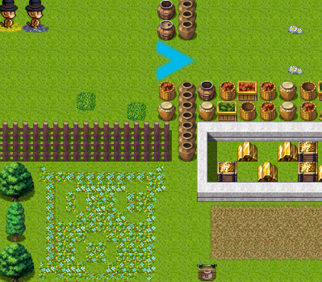
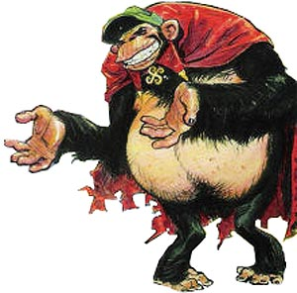
Apes with Capes

Slide 2
Overview
Screenshots (To bring you up to date)
Technology & Architecture
Graphics Engine
Cloud Rendering
Miscellaneous
Play the game!

Slide 3
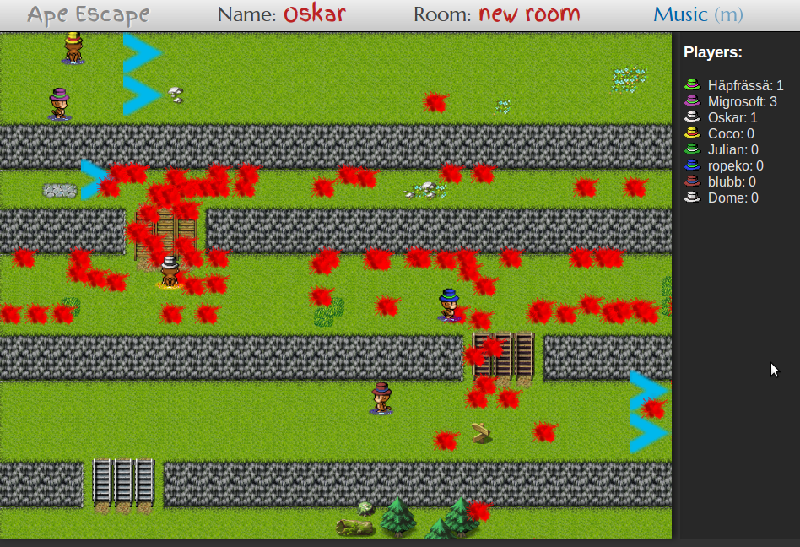
Screenshots

Slide 4
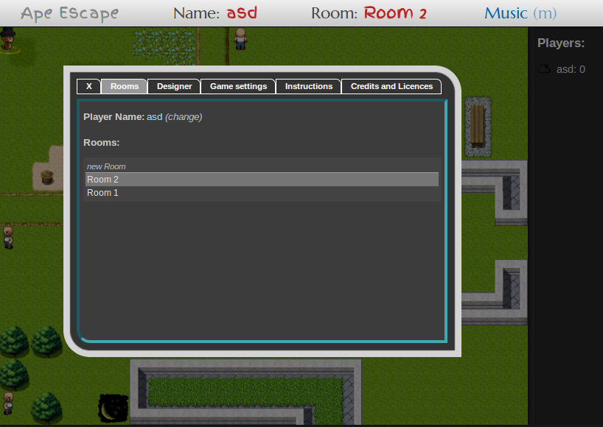
Screenshots

Slide 5
Technology & Architecture

Slide 6
Technologies
Client Side: JavaScript, CSS, HTML5
Server Side: Java Model, Webbit Server
Communication: WebSockets

Slide 7
Architecture
I want to move up!
Some guy wants to move up.
Move this guy up.
Client Side
Server Side
Browser
Webbit
Game Handler
Game
Browser
Game
Browser

Slide 8
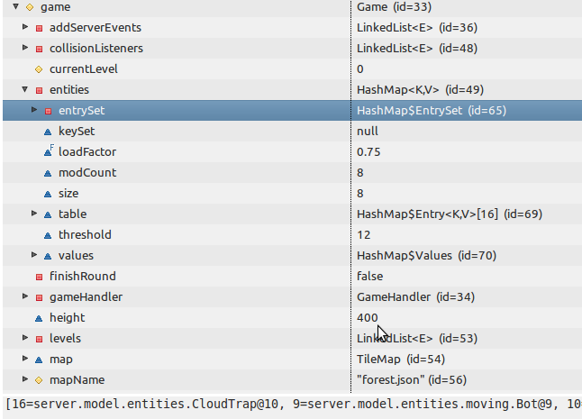
Server Side Representation

Slide 9
An Update via JSON
Game
{"action":"UPDATE",
"entities":{
"8":{"name":"asd","isWinner":false,"points":0,"id":8,"x":0.0,"y":0.0,"height":20.0,"width":20.0,"dirX":1,"dirY":0
,"type":"player"},
"9":{"id":9,"x":210.0,"y":0.0530729,"height":20.0,"width":20.0,"dirX":0,"dirY":-1,"type":"bot"},
"16":{"id":16,"x":90.0,"y":330.0,"height":20.0,"width":20.0,"dirX":1,"dirY":0,"type":"cloudtrap"},
"12":{"id":12,"x":570.0,"y":570.0,"height":20.0,"width":20.0,"dirX":1,"dirY":0,"type":"finish_flag"},
"13":{"id":13,"x":270.0,"y":240.0,"height":20.0,"width":20.0,"dirX":1,"dirY":0,"type":"turret"},
},
"playerId":8,
"events":[
"PUSH_MESSAGE":{"content:":"Game starts in 5 seconds!", "duration":1000}
"PLAY_SOUND":{"sound":"hit"}
],
"gameRunning":false
}

Slide 10
Architecture
Client Side
Server Side
Browser
Webbit
Game Handler
Game
Browser
Game
Browser

Slide 11
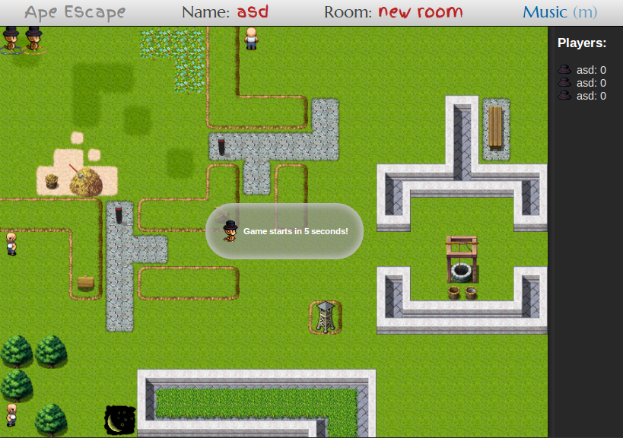
JavaScript Graphics Engine

Slide 12
Miscellaneous

Slide 13
Difficulties
Different Technologies
Dependency on Webbit Server
Racing conditions: Websocket vs Game Thread
Behaviour of local testing vs online

Slide 14
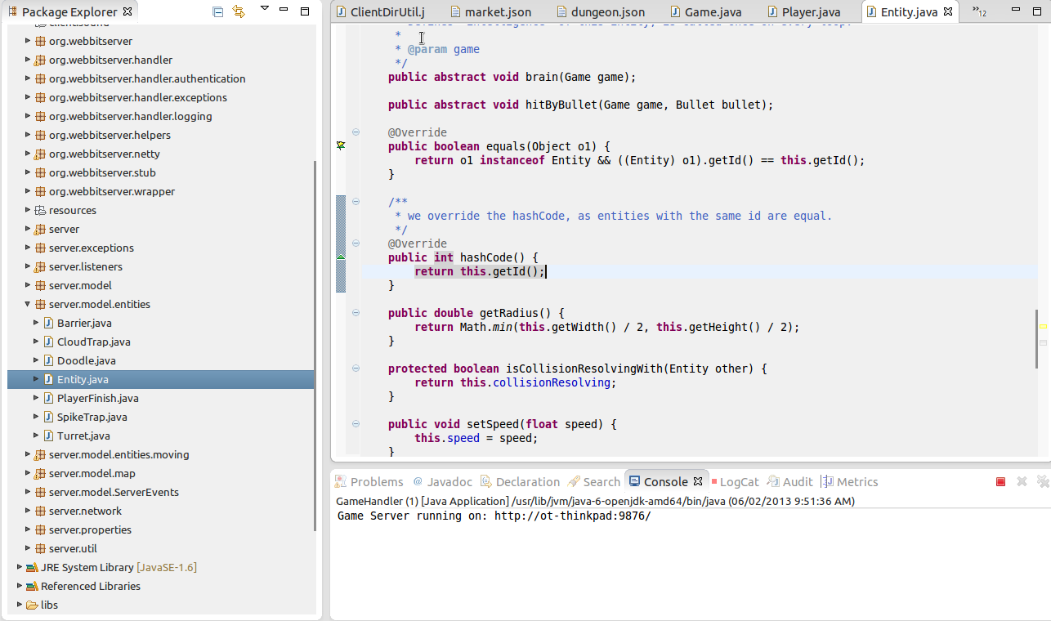
Development Environment
Eclipse

Slide 15
Metrics
~3000 Lines of Java Code
~2000 Lines of JavaScript Code

Slide 16
Future Possibilities
More intrinsic values
  More Hats
  More Levels
  Ladder Ranking
  Different Monkeys
  Keep score of how many games you’ve won

Slide 17
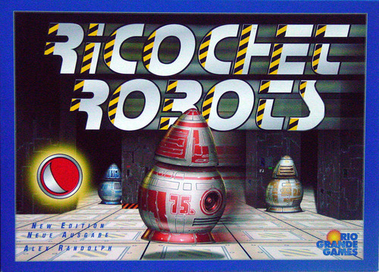
Future Possibilities
Home made Graphics
More Sounds
More Animations
More Levels
Chat Client
Similar Board Game
  For inter-media
  Similar to Ricochet Robots

Slide 18
Future Possibilities
Aim Bananas with mouse
Stabilize Connection
Make it Bug free!

Slide 19
Questions?

